Slide 1
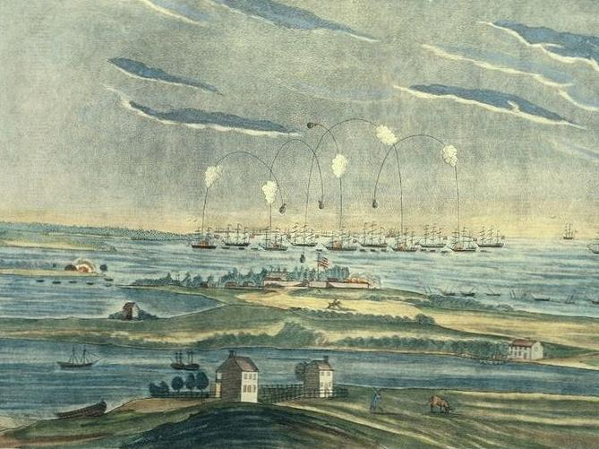
© Students of History - http://www.teacherspayteachers.com/Store/Students-Of-History

Slide 2
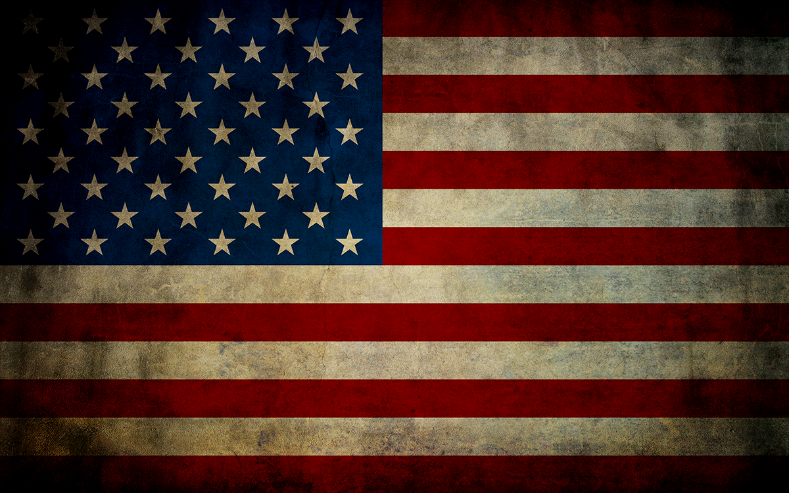
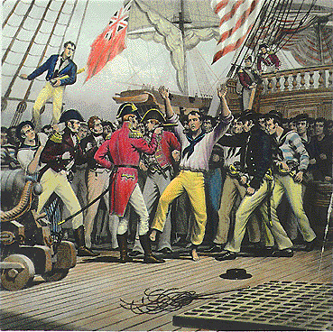
Impressment- British were stopping American ships and forcing American sailors into the British navy

Slide 3
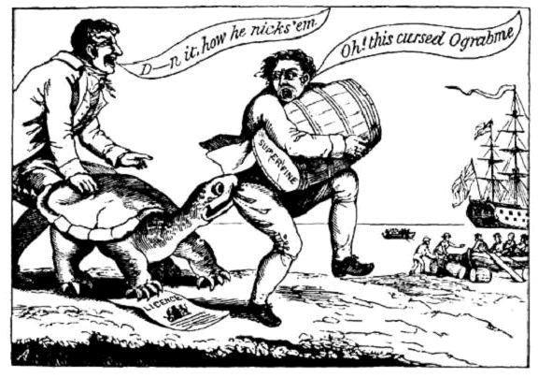
Britain was seizing American ships landing in French ports – a violation of neutral rights & taking cargo
The Embargo Act of 1807- attempted to solve problem diplomatically by closing all American ports to foreign trade but was unpopular

Slide 4
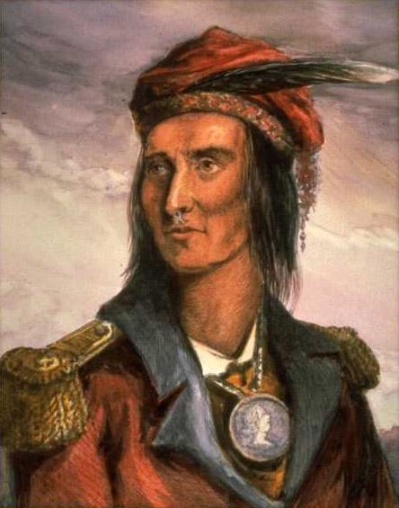
Tecumseh, Shawnee Indian chief, attacked frontier settlements
Americans believed the British encouraged the Shawnee to attack
William Henry Harrison defeated the Shawnee at the Battle of Tippecanoe and the final defeat and the death of Tecumseh occurred at the battle of the Thames

Slide 5
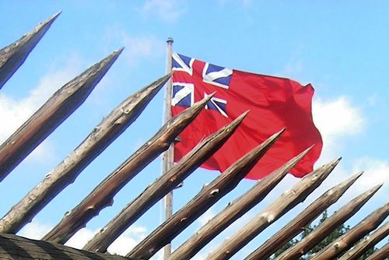
British have not left the forts in the Ohio River Valley and are limiting territorial expansion opportunities in the West
This is also a matter of national pride.

Slide 6
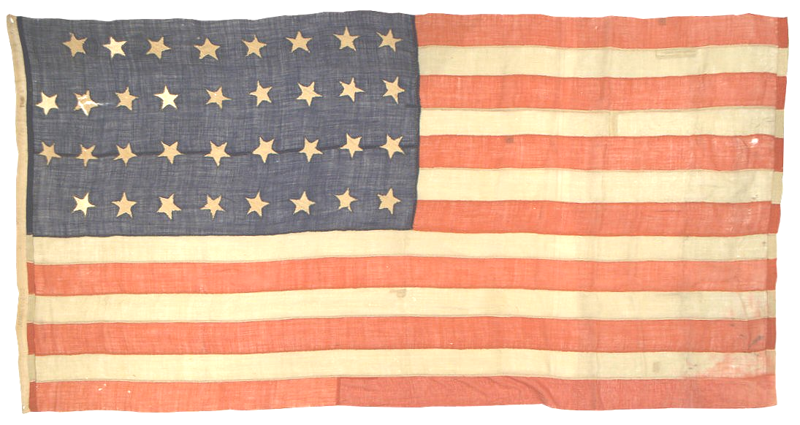
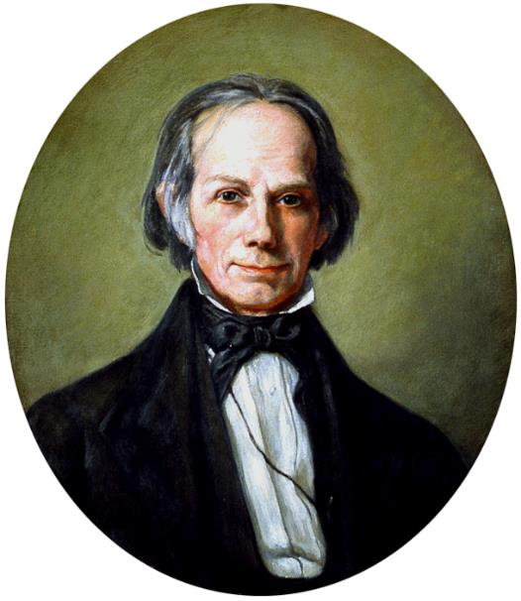
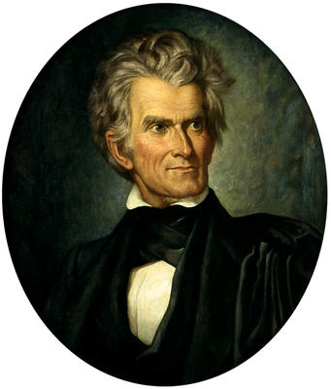
“War Hawk” Republicans- mostly from the West and South
Henry Clay of Kentucky- Speaker of the House of Representatives
John Calhoun- Senator from South Carolina

Slide 7
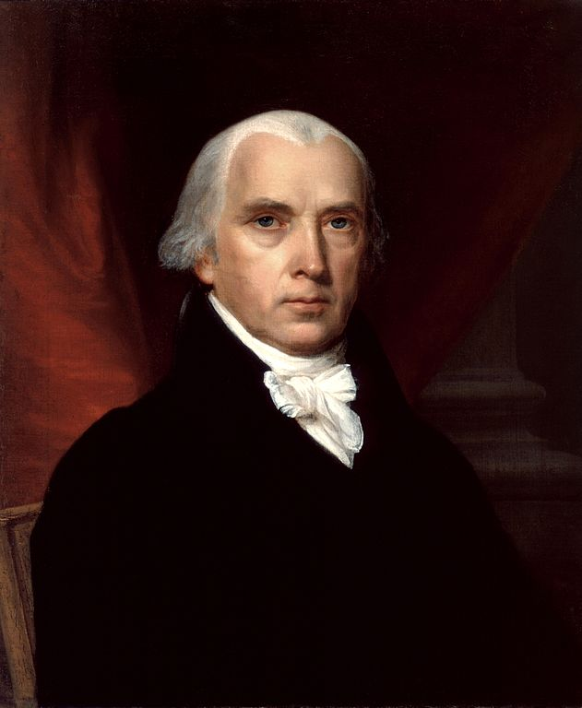
In June 1812, President James Madison asks Congress for a Declaration of War

Slide 8
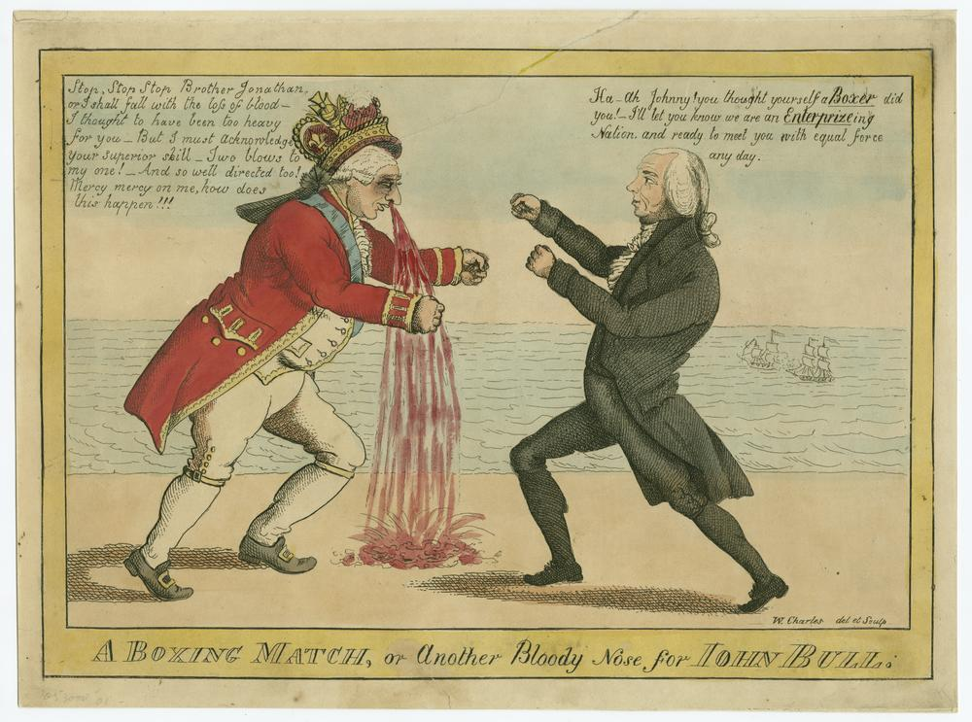

Slide 9
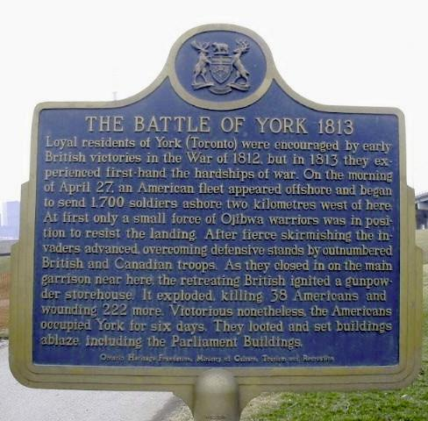
US win victory in York (present day Toronto)
Troops loot and burn the fort and town (the capital city)

Slide 10
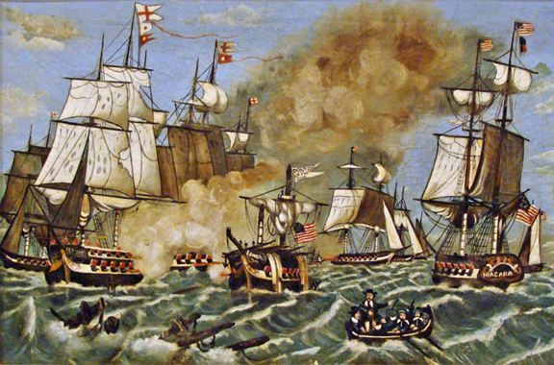
Battle of Lake Erie
US win victory on Lake Erie
Oliver Hazard Perry built a small fleet and defeated the mighty British Navy to take control of Lake Erie

Slide 11
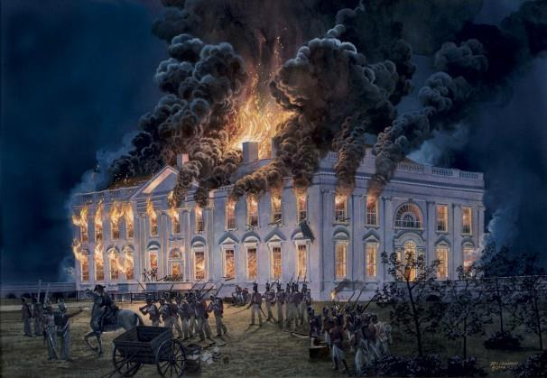
British capture DC in Aug. 1814
Set fire to the Presidential mansion & Capitol
Madison escaped to VA & Dolley Madison saves many valuables

Slide 12
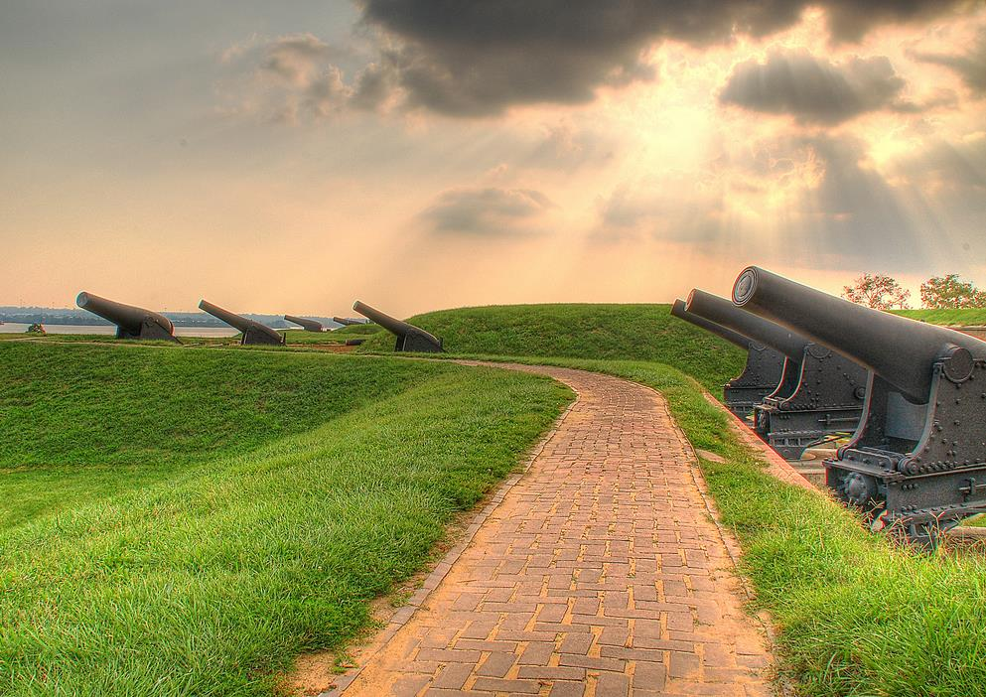
British advance to Baltimore
They bombard Ft. McHenry in Sept. 1814
Francis Scott Key witnesses the attack & his poem about it becomes our National Anthem

Slide 13
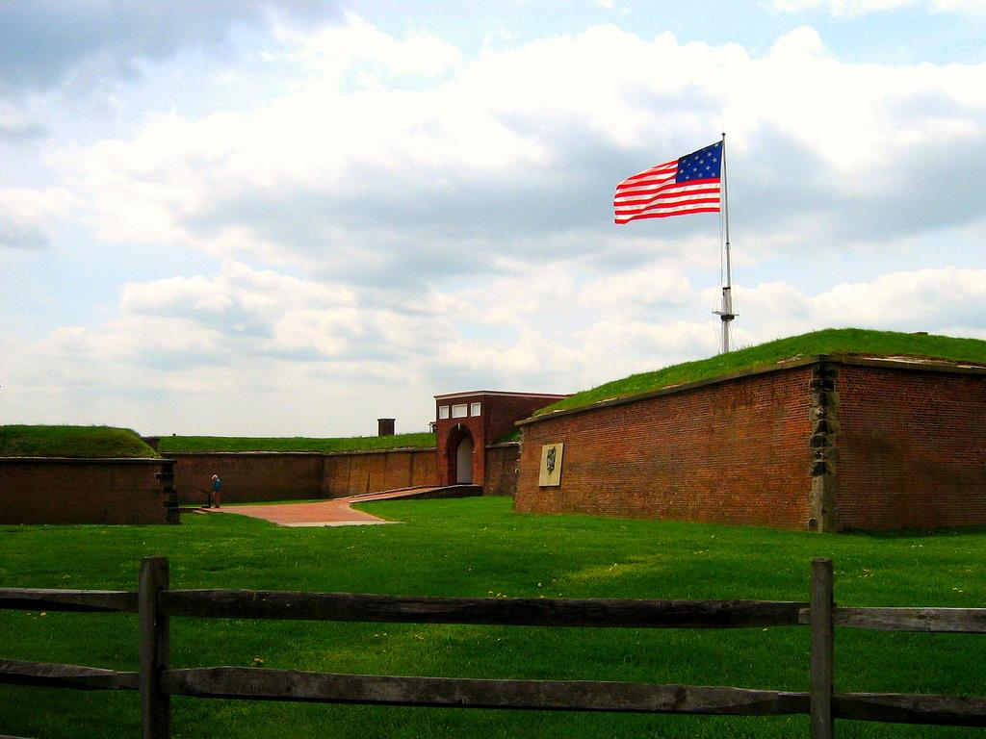
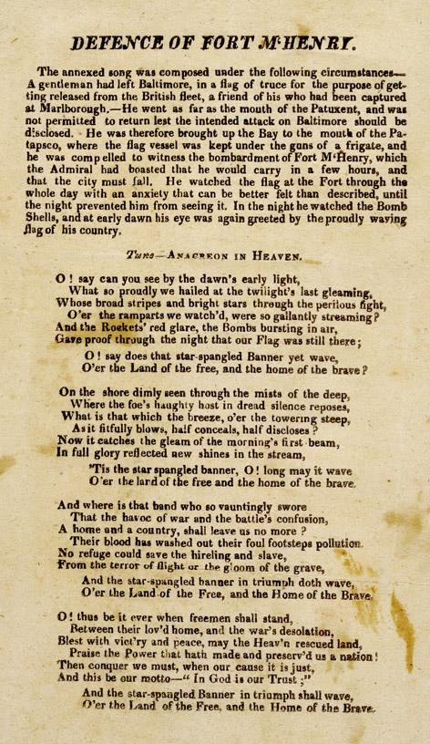

Slide 14
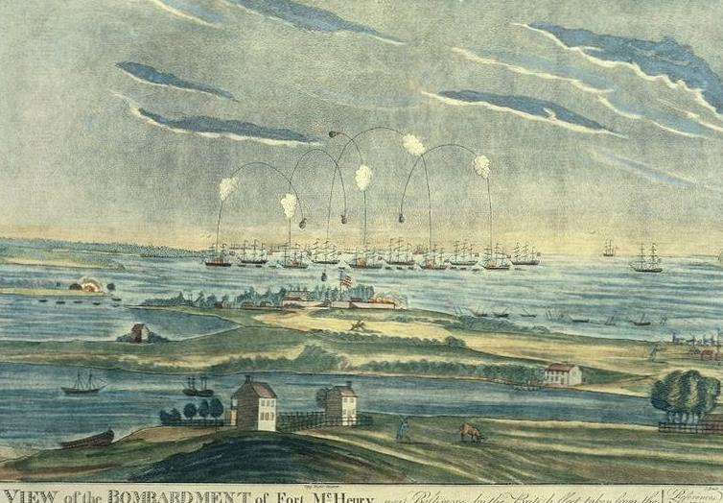
Exit Ticket
Where was the Star Spangled Banner written?
What was going on?
What motivated Francis Scott Key to write this poem?
The Star Spangled Banner
O! say can you see by the dawn's early light,
What so proudly we hailed at the twilight's last gleaming,
Whose broad stripes and bright stars through the perilous fight,
O'er the ramparts we watched, were so gallantly streaming.
And the rockets' red glare, the bombs bursting in air,
Gave proof through the night that our flag was still there;
O! say does that star-spangled banner yet wave,
O'er the land of the free and the home of the brave?
© Students of History - http://www.teacherspayteachers.com/Store/Students-Of-History

Slide 15
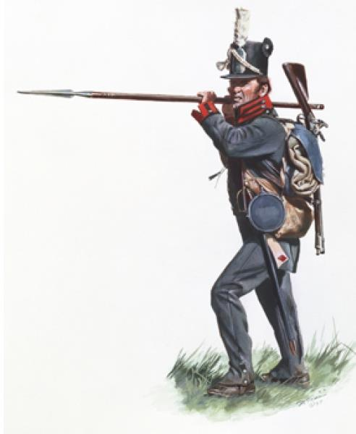
After battles across all of North America, a treaty is negotiated in Dec. 1814
The war ends in a stalemate with neither side gaining or losing territory
© Students of History - http://www.teacherspayteachers.com/Store/Students-Of-History

Slide 16
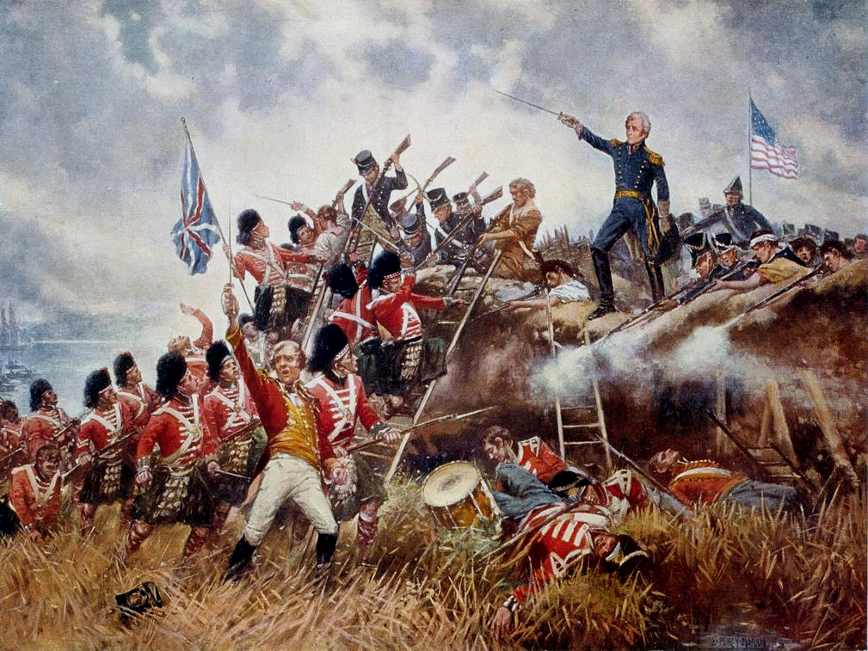
Word of the Treaty has not yet reached New Orleans
In Jan. 1815, Gen. Andrew Jackson decisively defeats the invading British
Makes Andrew Jackson a national hero

Slide 17
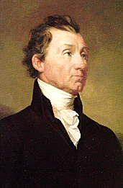
Surge in American Nationalism (Patriotism)
Election of James Monroe
The Era of Good Feelings- 1817-1825
One political party- The Republicans dominate politics

Slide 18
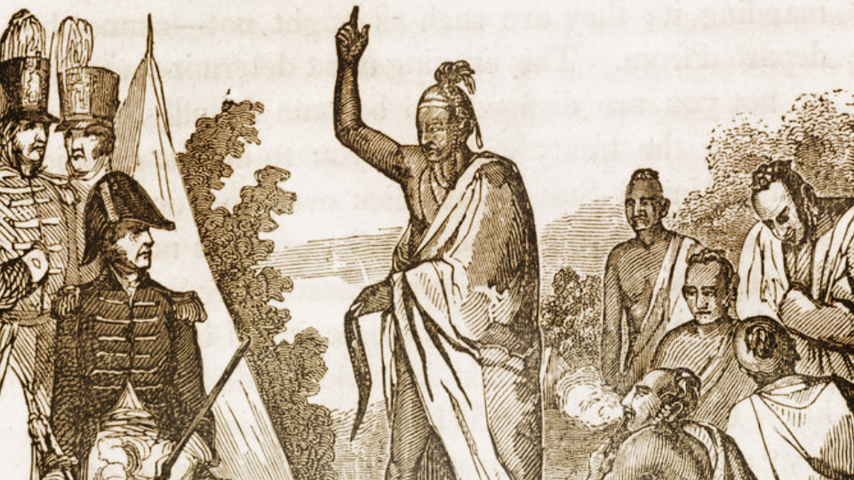
Native Americans:
Because Tecumseh died in Battle of the Thames River , many Native American Groups break alliances
Creek War – Creek give up 1000’s of acres of land in Treaty of Fort Jackson

Slide 19
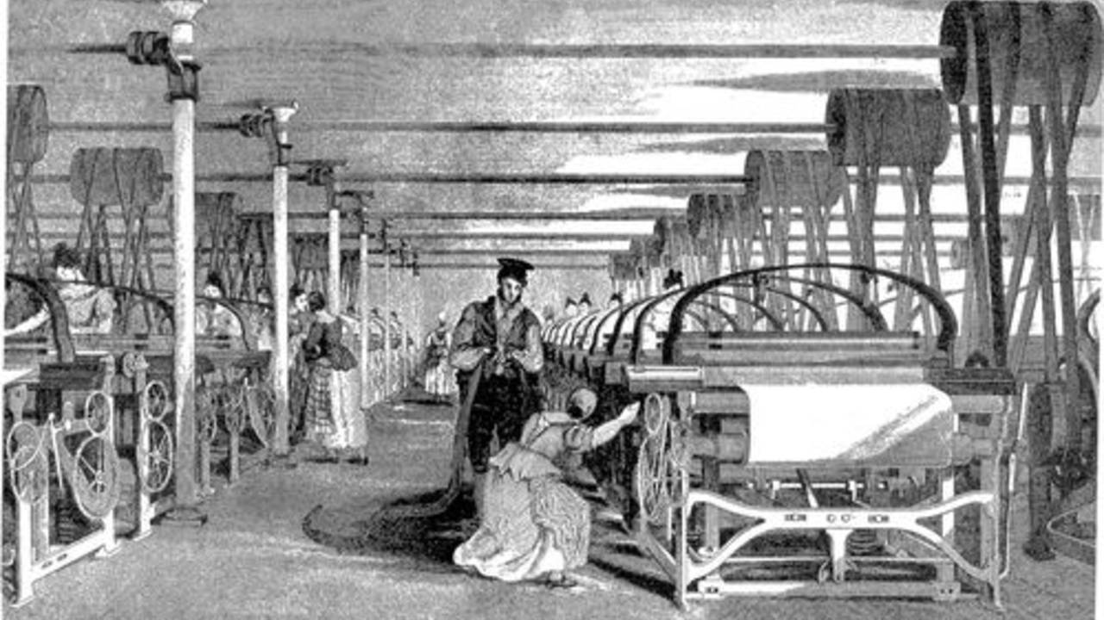
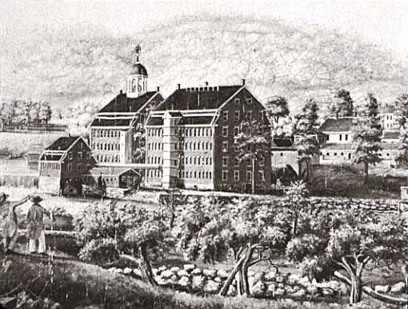
INCREASED MANUFACTURING –
Because we didn’t like relying on trade with England and France, we begin to build our own factories and produce our own goods.

Slide 20
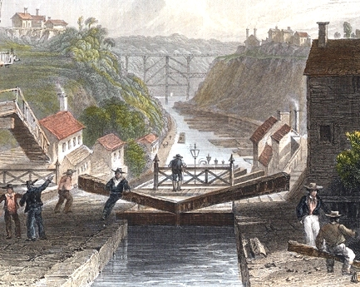
Economic Nationalism through Henry Clay’s American System to unite the country
3 parts - A Protectionist Tariff, 2nd National Bank, Internal Improvements (roads, canals, & railroads)

Slide 21
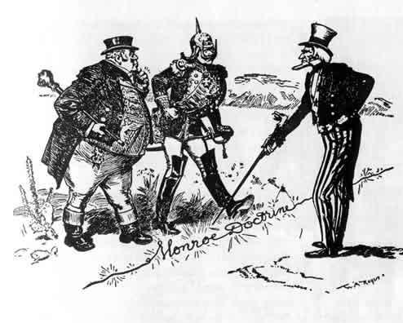
US increased its stature in the world
Monroe Doctrine asserts US’ role in Western Hemisphere
Adams-Onis Treaty with Spain brings Florida into the US

